Slide 1
AI-Powered Secure Image Steganography Using Deep Learning
CAPSTONE PROJECT
Presented By:Shubham Mahadik
College Name & Department : Terna Enginnering College

Slide 2
OUTLINE
Problem Statement
Technology used
Wow factor
End users
Result
Conclusion
Git-hub Link
Future scope

Slide 3
Problem Statement
Traditional image steganography techniques like Least Significant Bit (LSB) substitution are vulnerable to steganalysis attacks and data loss due to compression. This project aims to enhance security and robustness by using a Deep Learning-based Autoencoder for hiding and extracting images securely.

Slide 4
Technology used
Programming Language: PythonDeep Learning
Framework: TensorFlow, Keras
Libraries: OpenCV, NumPy,
MatplotlibPlatform: Google Colab

Slide 5
Wow factors
✅ Uses AI-powered autoencoder instead of traditional LSB methods
✅ More secure and robust against steganalysis attacks
✅ Works on JPEG, PNG, and BMP image formats
✅ Supports automated feature learning for hiding and extracting images

Slide 6
End users
Cybersecurity Experts: Secure data transmission
Forensic Analysts: Hidden data retrieval
Government & Defense Agencies: Confidential communication
Journalists & Whistleblowers: Secure message sharing

Slide 7
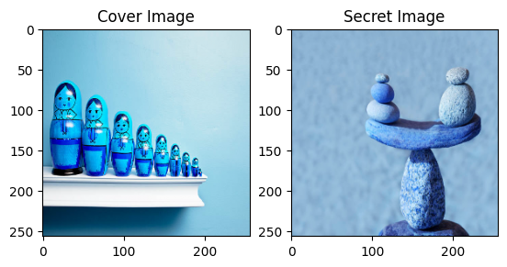
Results
Cover Image: Original image used to hide data

Slide 8
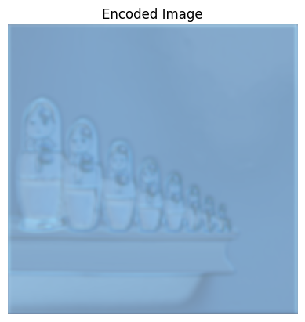
Results
Encoded Image: Visually identical to the cover image but contains a hidden image

Slide 9

Results
Extracted Image: Successfully retrieved hidden image using the trained model

Slide 10
Conclusion
This project successfully demonstrates AI-powered steganography by using deep learning autoencoders to hide and extract images securely. It improves data security and robustness against detection compared to traditional techniques

Slide 11
GitHub Link
https://github.com/swag64/steganography.git

Slide 12
Future scope(optional)
Improve model accuracy with larger datasets
Implement video steganography
Develop a mobile app for real-world use
Apply GANs (Generative Adversarial Networks) for enhanced security

Slide 13
THANK YOU

